Slide 1
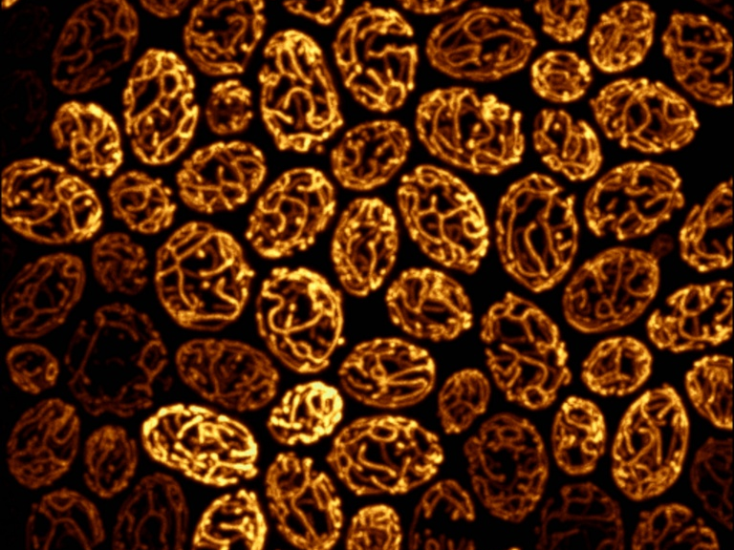
Designing a Microscopy Experiment
Kurt Thorn, PhD
Director, NIC@UCSF
Image from Susanne Rafelski, Marshall lab

Slide 2
The Chinese-menu view of imaging
Imaging Methods
Wide-Field
TIRF
Laser-scanning confocal
Multi-point confocal
Multi-photon confocal
Contrasting techniques
Brightfield, phase, DIC
Immunofluorescence
Physiological dyes
Fluorescent proteins
FRAP, FLIP, photoactivation
FRET, FLIM
Experiment: Time Lapse, 3D, multi-point, multi-wavelength, …

Slide 3
Standard microscope capabilities
Like all rules, these were made to be broken, but only if you have fancy equipment!
Resolution: ~200nm in X and Y, 700 nm in Z
Sensitivity: <100 photons
Linear detection – quantification is possible
Video rate acquisition
4-5 color imaging

Slide 4
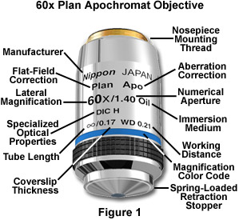
By far the most important part: the Objective Lens
Obviously, we care about the magnification. What other parameters are important?

Slide 5
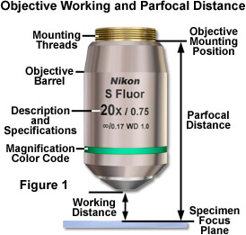
Working Distance
In general, high NA lenses have short working distances
However, extra-long working distance objectives do exist
Some examples:
10x/0.3 WD = 15.2mm
20x/0.75 WD = 1.0mm
100x/1.4 WD = 0.13mm

Slide 6

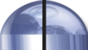
Numerical Aperture
100X / 0.95 NA
α = 71.8°
NA = n sin(α)
4X / 0.20 NA
α = 11.5°
where
= light gathering angle
n = refractive index of sample

Slide 7
Resolution of the Microscope
limited by the point-spread function
Microscope objective collects a limited cone of light from the sample
This limits the resolution achievable by the microscope
Resolution can be measured by the blurring of a point object → the point-spread function
Objective
α
Sample

Slide 8
Resolution of the Microscope
limited by the point-spread function
Microscope objective collects a limited cone of light from the sample
This limits the resolution achievable by the microscope
Resolution can be measured by the blurring of a point object → the point-spread function
Y
X
Z

Slide 9
Resolution of the Microscope
limited by the point-spread function
Resolution: X-Y, 0.61λ / NA; Z, λn / NA²
Resolution for some common objectives, in nm:
NA | X-Y | Z
0.3 | 1017 | 16830
0.75 | 407 | 2690
0.95 | 321 | 1680
1.4 | 218 | 770

Slide 10
Light-gathering power
Light-gathering power goes as the square of NA
All things being equal, a higher NA lens will give a brighter image
Increasing magnification generally decreases brightness as light is spread out over more pixels
NA | Brightness
0.3 | 0.09
0.75 | 0.56
0.95 | 0.90
1.4 | 1.96

Slide 11
Choosing an objective
Questions:
What resolution do you need?
How bright is your sample?
For high resolution, you’ll need high NA.
For dim samples, you’ll want high NA, regardless of resolution, to maximize light-gathering.
Dim, low-resolution samples (e.g. protein abundance in nucleus): bin camera to trade off resolution for brightness

Slide 12
Choosing an objective
Questions:
What resolution do you need?
How bright is your sample?
When to use low NA?
Bright samples at low resolution / low magnification
If you need long working distance
If spherical aberration is a concern
If you want large depth of field to get whole structures in focus at once (avoid Z-stacks)

Slide 13
NA, Z-resolution, and Z-stacks
Idea – want to record total nuclear fluorescence
Depth of field
nucleus
High NA
Low NA
nucleus
Need multiple Z-sections to capture entire nucleus
Only need a single image to capture entire nucleus

Slide 14
Confocal Microscopy
Confocal microscopy has the same resolution as widefield, but eliminates out-of-focus light.
This improves contrast for thick, heavily stained specimens.
However, it usually comes at a cost in sensitivity.

Slide 15
Fluorescence Illumination of a single point
Camera
Tube lens
Excitation light
Emission light
Objective lens
Sample
Problem – fluorescence is emitted along entire illuminated cone, not just at focus

Slide 16
The confocal microscope
Detector
Pinhole
Tube lens
Excitation light
Emission light
Objective lens
Sample

Slide 17
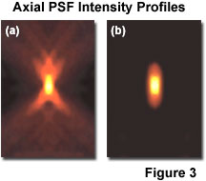
What do you get?

Slide 18
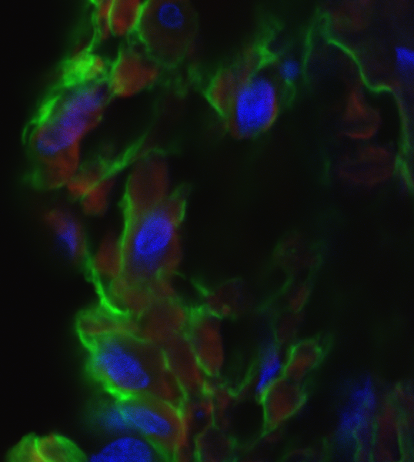
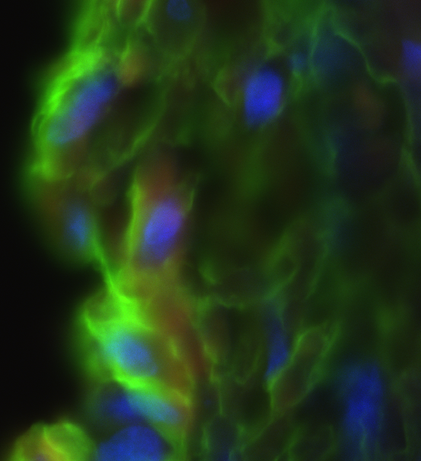
Confocal vs. Widefield
Confocal
Widefield
20 μm rat intestine section recorded with 60x / 1.4NA objective

Slide 19
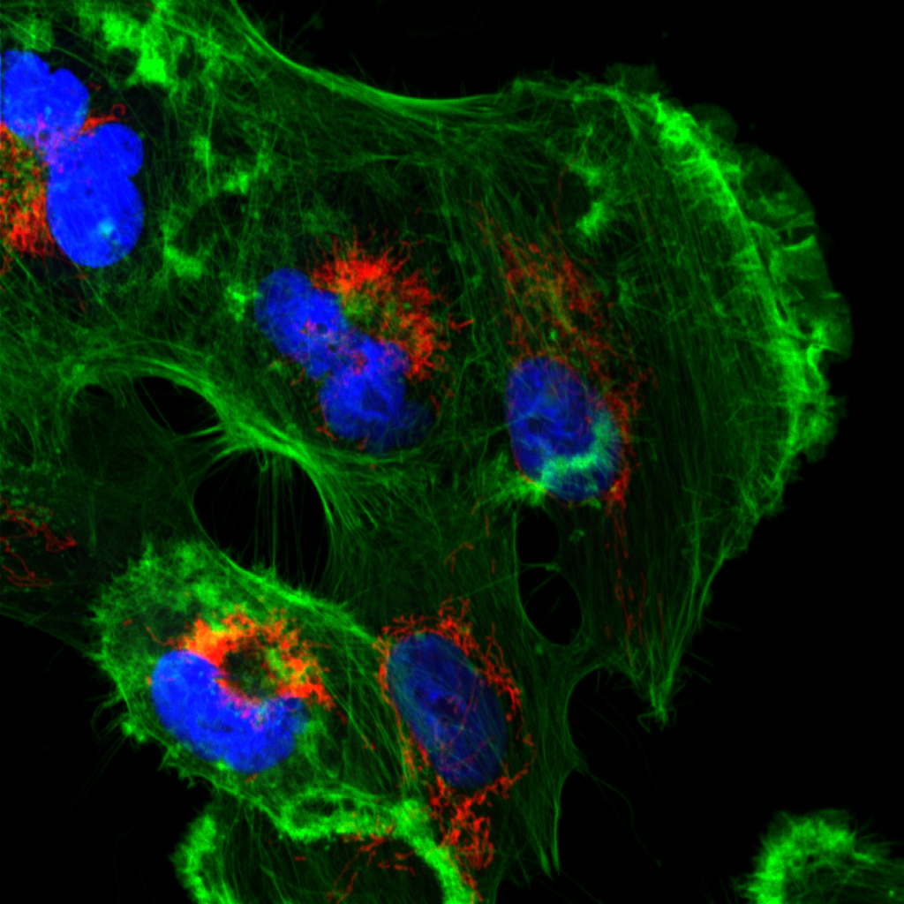
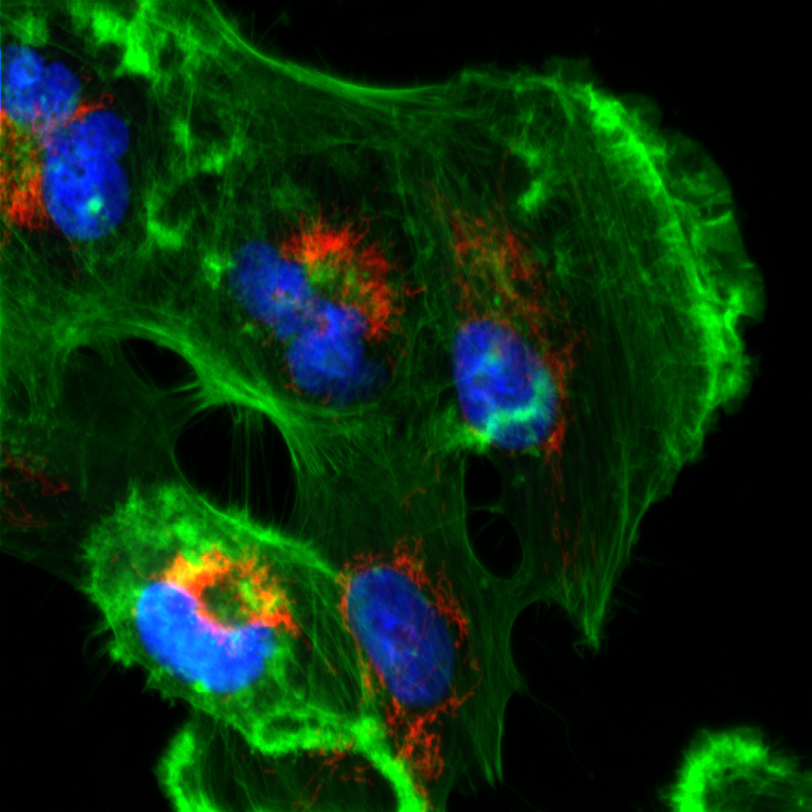
Confocal vs. Widefield
Confocal
Widefield
Tissue culture cell with 60x / 1.4NA objective

Slide 20
The confocal microscope
Scan excitation spot point-by-point to build up image
Problems:
Slow (~1 sec to acquire an image)
Low light efficiency (due to use of PMT as detector)
Solution:
Use multiple pinholes and a camera
Detector
Pinhole
Tube lens
Excitation light
Emission light
Objective lens
Sample

Slide 21
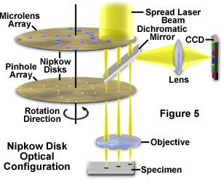
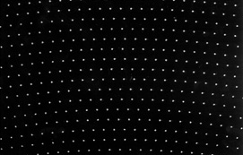
Spinning Disk Confocal

Slide 22
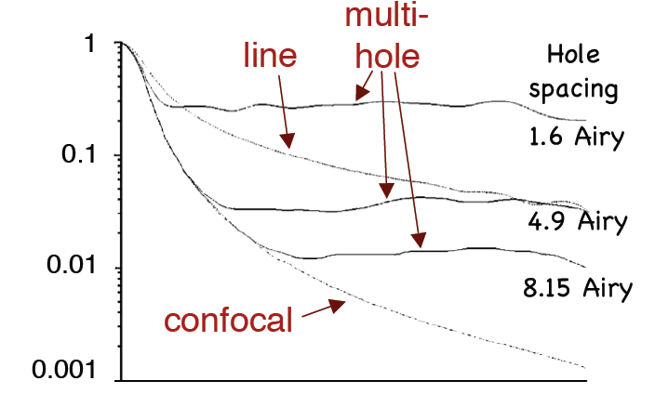
Out-of-focus rejection
T
Defocus

Slide 23
Relative Sensitivity
Widefield 100
Spinning-Disk Confocal 25
Laser-scanning Confocal 1
See Murray JM et al, J. Microscopy 2007 vol. 228 p390-405

Slide 24
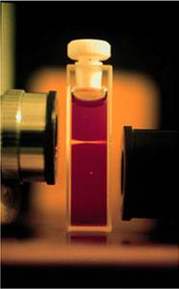
Multi-photon excitation
Internal
conversion
S₁
hν_{A}
hν_{A}
hν_{E}
hν_{A}
S₀
2
1
0
Brad Amos, MRC, Cambridge
Multi-photon excitation does not excite out-of-focus light, so you can get rid of pinhole

Slide 25
Total Internal Reflection: TIRF
Thinnest optical sections: Images ~100nm section adjacent to coverslip
Illuminate through the
objective
Na_{beam}:
1.38
Sample on
cover glass
Intensity
1.42
1.46
Z

Slide 26
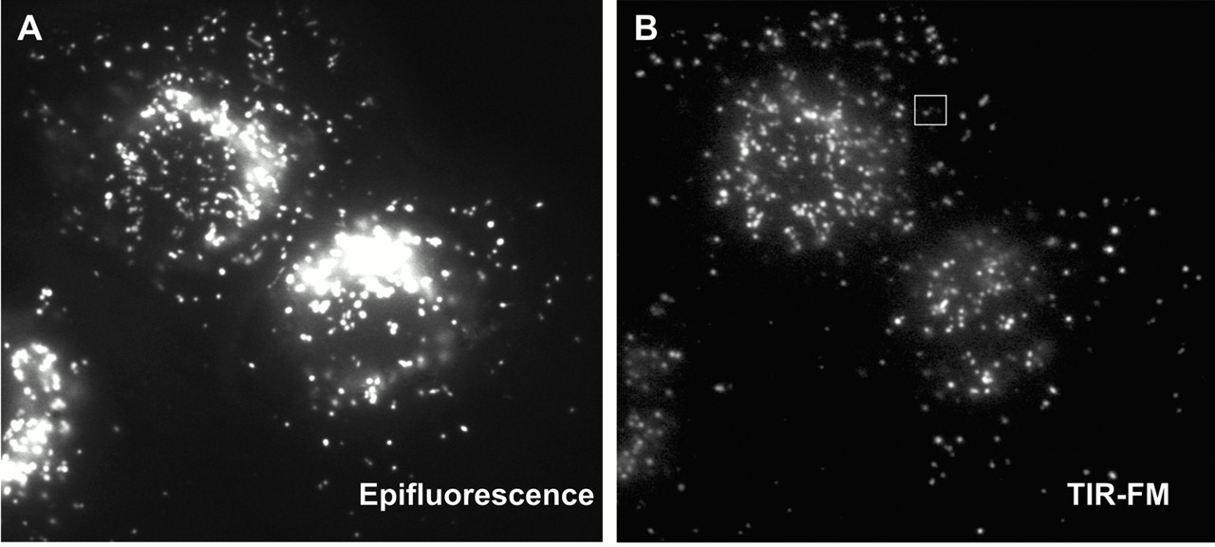
Epifluorescence vs. TIRF
Jaiswal et al 2002; cells loaded with FITC-dextran

Slide 27
Which imaging technique should I use?
1-5 μm
TIRF (for samples at the coverslip)
Wide-field (+deconvolution)
1-20 μm
Fast
Spinning Disk Confocal
Sample Thickness
Sensitivity
10-100 μm
Line-scanning confocal
>20 μm
Point scanning Confocal
Slow
>50 μm
2-photon confocal

Slide 28
Microscope choice
Epifluorescence – routine work, low magnification, or thin samples where you don’t need high-resolution 3D reconstruction
TIRF – samples at the membrane or otherwise at the coverslip surface; very high signal-to-noise; single molecule imaging
Spinning Disk Confocal – Live tissue culture cells, yeast, etc, or thin (<30 μm) tissue sections when you need 3D reconstructions
Laser-Scanning Confocal – Thick tissues or specimens

Slide 29
Sample preparation and mounting
Mounting media serve several purposes:
Stabilizing the sample
Preventing photobleaching
Clearing the sample
Matching refractive index

Slide 30
Index Mismatch
& Spherical Aberration
objective
n₁
Immersion
fluid
Cover glass
n₂
Sample
Focus at cover slip
Focus
into sample
Spherical aberration
unless n₂ = n₁

Slide 31
Index Mismatch
& Spherical Aberration
z=0 µm
n₁=1.515 (oil)
z=25 µm
n₂=1.44
(Vectashield)
z=50 µm

Slide 32
What can you do about spherical aberration?
Use 0.17 mm coverslips (~ #1.5)
Work close to the coverslip
Match lenses to the refractive index of your samples, and vice versa
For aqueous samples, use water immersion / water dipping lenses
For fixed samples and oil immersion lenses, mount your sample in a medium with n = 1.515
Adjust objective correction collar when available
Use lower NA lenses

Slide 33
Clearing
Clearing media dissolve lipids to make samples more transparent
Can be important for thick samples and tissues
Commonly used:
BABB = 1:2 Benzyl Alchohol : Benzyl Benzoate
Methyl Salicylate

Slide 34
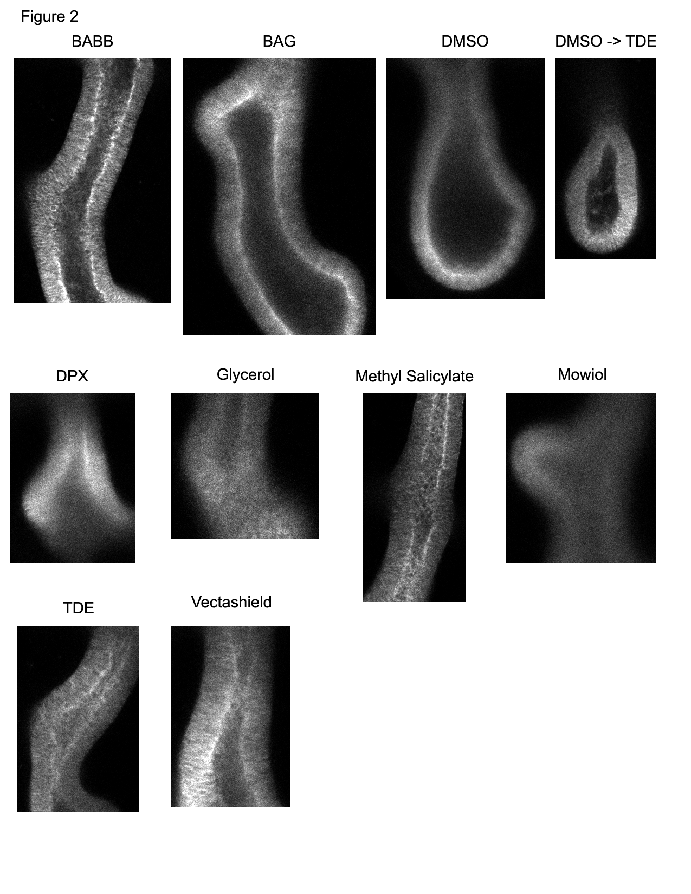
Sample Preparation
Samples imaged with 20x / 0.75 air objective on spectral confocal
Sections acquired ~ 50 μm into tissue
Embryonic mouse lungs; samples from Nan Tang, Martin Lab

Slide 35
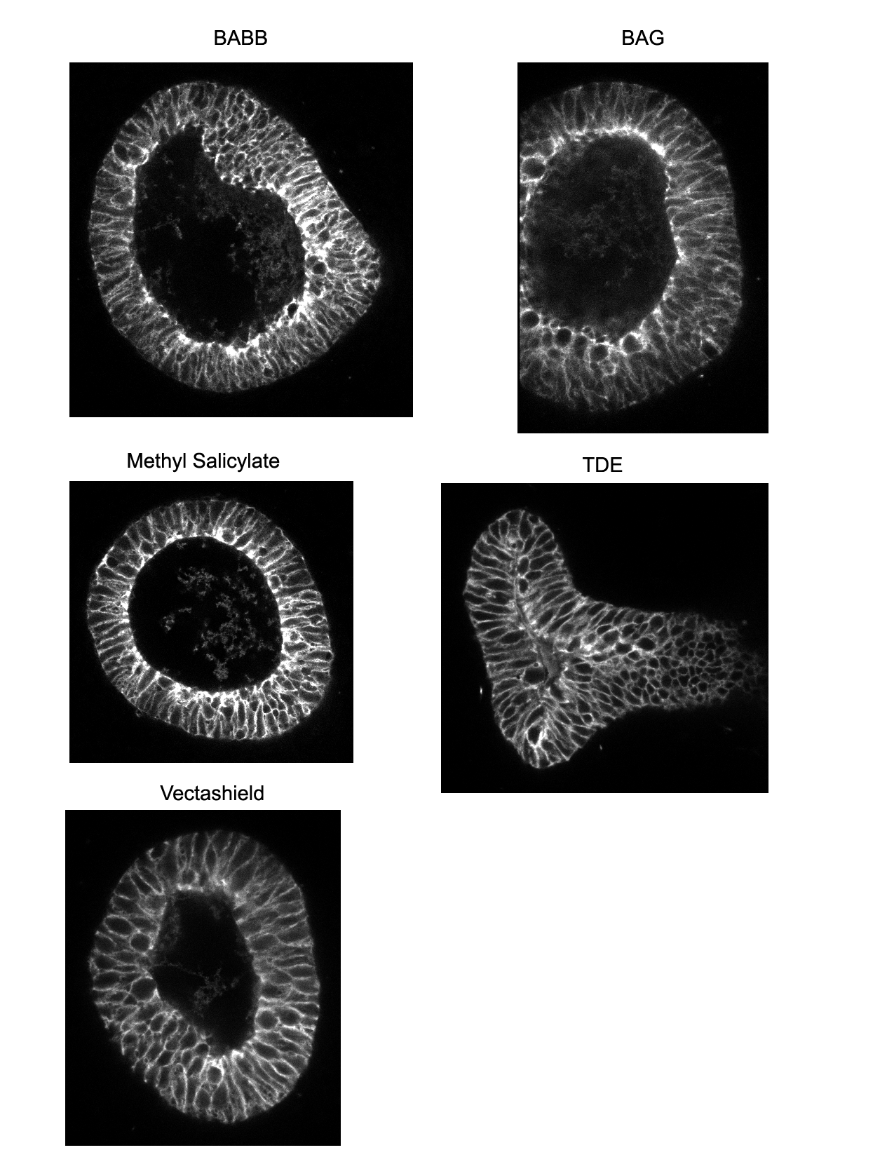
Sample Preparation
Samples imaged with 40x / 1.3 oil objective on spectral confocal
Sections acquired ~ 50 μm into tissue
Embryonic mouse lungs; samples from Nan Tang, Martin Lab

Slide 36
Dye choices – Fixed samples
Common filter set is DAPI / FITC / Rhodamine / Cy5
Dye choices:
DAPI / Hoechst / Alexa 350 / Alexa 405
Alexa 488
Rhodamine / Alexa 546 / Alexa 568
Cy5 / Alexa 647 / Atto 647
More than four colors probably requires special filters or spectral imaging.

Slide 37
Dye choices – Live samples
Common filter sets: GFP / mCherry, CFP / YFP, CFP / YFP / RFP
Two-color choice: GFP / mCherry
Three-color: CFP / GFP / mCherry or CFP / YFP / mCherry or BFP / GFP / mCherry
Four-color: BFP / CFP / YFP / mCherry or Sapphire / CFP / YFP / mCherry
Five-plus colors: possible but tricky, probably requires custom filters or spectral imaging.

Slide 38
Time and noise - tradeoffs
The number of photons collected by the camera generally determines the amount of noise in your image
Noise = square root (# of photons)
Doubling signal to noise ratio requires 4-fold increase in exposure

Slide 39
What does this look like?
With 5 e⁻ camera read noise
1000 photons / pixel
100 photons / pixel
10 photons / pixel

Slide 40
Noise and resolution
Theoretical perfect data
Two spots separated by diffraction limit
Slightly oversampled

Slide 41
Noise and resolution
With shot noise
1000 ph/pixel at peak
100 ph/pixel at peak
10 ph/pixel at peak

Slide 42
Noise and resolution
Expected error bars with shot noise
1000 ph/pixel at peak
100 ph/pixel at peak
10 ph/pixel at peak

Slide 43
Noise and resolution
High resolution and precise quantitation both require lots of light
This means bright samples or long exposures
This may cause problems with photobleaching and phototoxicity
Be aware of potential tradeoffs between precision, speed, and photobleaching

Slide 44
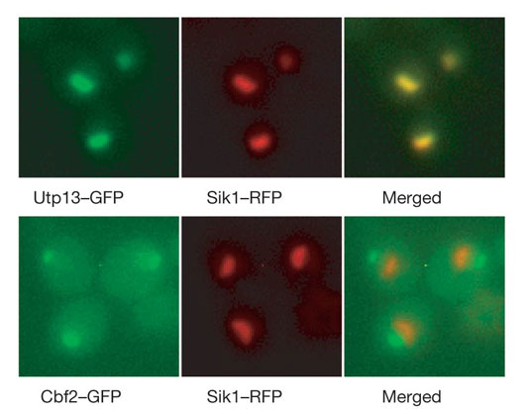
Colocalization
Measures co-occurrence within the resolution limit of the microscope.
Does not say anything about molecular interaction
Huh et al. 2003

Slide 45
Nothing beats good data
Think about what data you need before you take it.
Do you need
Time resolution?
Spatial resolution?
Intensity resolution?
Day-to-day reproducibility?
Spatial uniformity?
You can fix a lot of problems with post-processing, but it’s better to fix problems in the data collection!

Slide 46
If you care about it, you should measure it!
Spatial uniformity
Illumination and detection is not uniform over the field of view of the microscope.
Can be measured and corrected with a shading image.
Photobleaching may make this hard
Temporal uniformity
Lamp power and alignment fluctuates from day to day
Can measure
But best to do experiments same day / same session

Slide 47
Think about data storage
Databases are good, but cumbersome
Save in manufacturer’s native format so metadata is preserved
If not using a database, systematic file names and notes on sample identity are a good idea

Slide 48
References
Slides: http://nic.ucsf.edu/edu.html

